Slide 1
Introduction to Trees
Ratemaking and Product Management Seminar
San Diego, CA
Linda Brobeck, FCAS, MAAA
March 28, 2017

Slide 2
High Level Steps to a Predictive Analytics Project
Define the business problem
Determine the appropriate analysis type
Understand the analysis variables
Import data and summarize data for verification
Data adjustments and processing (joins, roll up, etc.)
Run one-way analysis
Model
Notes:
Data adjustments
How are you going to handle Missing Values
Create flags for missing values, sometimes missing values itself carry a good amount of information.
Assign missing value with mean/ median/ or some other method
How does software handle Missing Values ( ,.,na, nan<=lookup)
Consistency of data
negative losses
losses with no associated policy
negative premiums
date fields

Slide 3
Classification and Regression Trees Overview
n = 100
Y = 5’ 8”
Gender = Male
n=50
Y = 5’ 9”
Gender = Female
n=50
Y = 5’ 4”
Age ≤ 22
n=17
Y=5’7”
Age > 22
n=33
Y = 5’ 10”
< 5’ 6”
5’ 6” – 5’ 9”
SS≤ 8
n=5
Y=5’5”
SS 9-12
n=23
Y=5’10”
SS > 12
n=5
Y=6’3”
SS < 8
n=40
Y=5’3”
SS ≥ 8
n=10
Y=5’8”
5’ 10” – 6’
> 6’
Notes:
Based on the successive division of the problem into several sub-problems with a smaller number of dimensions.
The resulting trees are usually quite understandable and can be easily used to obtain a better understanding of the phenomenon in question.
100 Adults. Average Height (Y) = 5’8”. Can Gender, Age and Shoe Size predict Height?

Slide 4
Classification and Regression Trees Overview
Target/Response (Dependent) Variable:
Y: Height
“n” Explanatory (Independent) Variables:
X_{1,} X₂ … X_{n} : Gender, Age, Shoe Size
If the Target (Response) Variable is:
Categorical ➔ Classification Tree
Continuous ➔ Regression Tree
Notes:
Target Variables
The target variable represents the outcome we would like to predict (An important step that may not always be obvious like frequency, severity, or loss cost. For example the Fraud target variable of conviction “1” would categorize many claims that the company had previously investigated as not fraud “0”).
Explanatory Variables / Features
An explanatory variable is any factor that can influence the target variable.
For some analyses may want to append additional data to use as explanatory variables (example; insurance score, additional auto information, additional homeowners information).

Slide 5
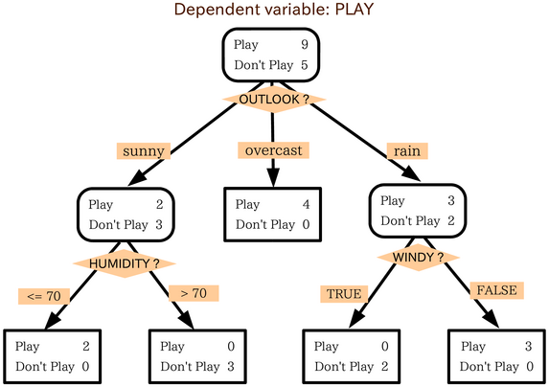
Classification and Regression Trees Overview
64% Likely to Play
40% Likely to Play
60% Likely to Play
100% Likely to Play
100% Likely to Play
0% Likely to Play
100% Likely to Play
Notes:
An example of a Classification Tree
The aggregate collection of subsets with attached predicted values is referred to as the “tree”.
Individual subsets are referred to as “leaves”.

Slide 6
CART Overview
Partition the explanatory variables such that:
The observed values of Y are homogeneous on each subset
The observed values of Y have small variance on each subset
The observed values of Y are easily predicted on each subset
The model balances predictive power with parsimony
Notes:
The GOAL of a tree
Parsimony serves two purposes:
Preference for simple models
Guards against over fitting

Slide 7
CART Overview
The domain space of explanatory variables X₁,…X_{n} is split into two subsets where observed values in X_{j} belong to one of the subsets < s, or >= s
The dimensions j and s above are chosen to minimize the error in the prediction among all such binary (two-leveled) trees. Process is iterated.

Slide 8
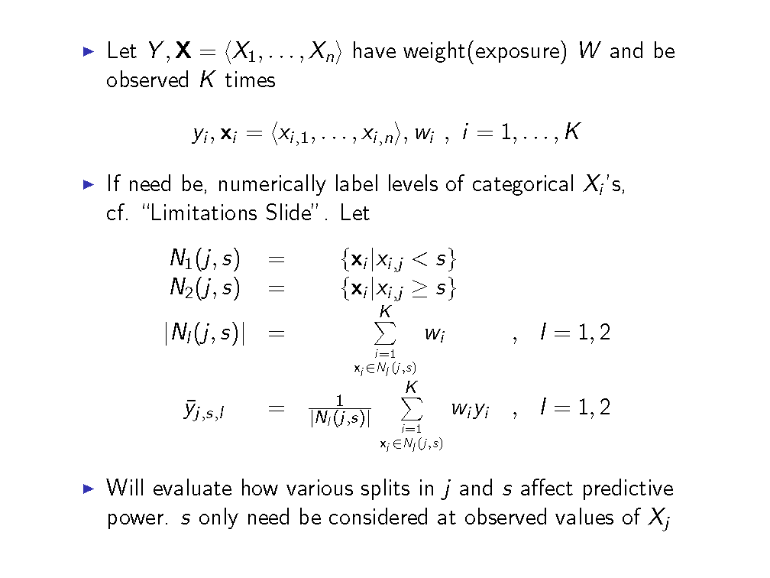
Mathematical Formalization

Slide 9
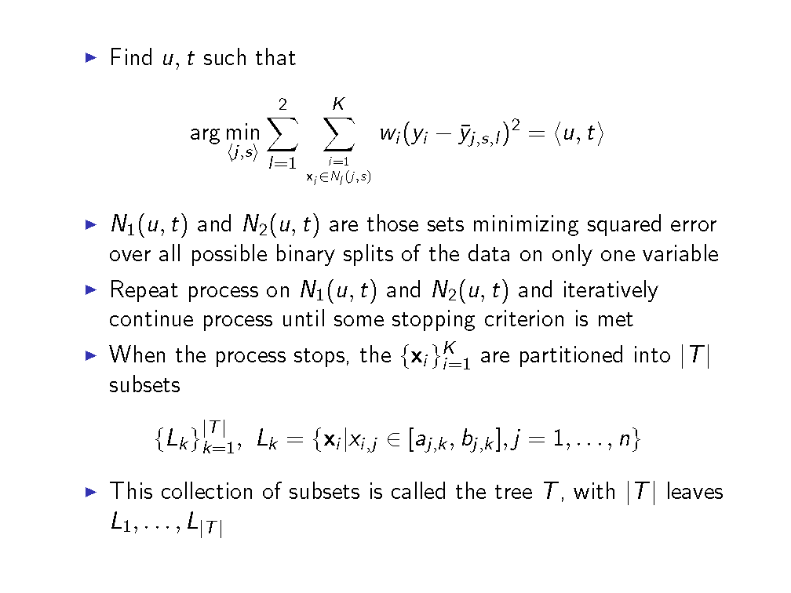
Mathematical Formalization

Slide 10
Avoiding Over Fit
Train
Validation
The validation dataset ensures a valid way to accurately measure your model’s performance.
Given a large enough volume of data, use of a test dataset will help estimate the accuracy of the selected approach.
Train
Validation
Test
Notes:
Explanatory vs. Predictive
Typically with the volume of data we work with, we will build the model using the training dataset, then use the validation data set to verify the accuracy of the model’s output.
There is a risk of overfitting your model if you do not split your dataset. A model that is overfitted for a specific data set will not perform as well when you run it on other datasets.
Methods of splitting data:
Use random assignment of data based on targeted division (example: 70/30 of all data)
Use random assignment of policies to targeted division (example: 70/30 of policy number)
This has the advantage that you retain historical information of a policy
Also will not have the same policy straddling both the Training and Validation set
Using the most recent year as the holdback set, or other variations

Slide 11
Interactions
Two explanatory variables interact if they combine non-additively to affect the target
A Decision Tree can automatically capture interactions
Traditional regression requires an explicit interaction term
A Decision Tree of depth D can capture interactions of order up to D

Slide 12
Stopping Criterion
No stopping criterion gives full tree, all available attributes and combinations have been accounted for
Can set a minimum leaf size or maximum number of splits (tree depth)
Balance predictive power with parsimony
Too many leaves tend to over-fit data
Too few leaves produces a poor predictor
There is a methodological approach to let data determine the stopping criterion (see Appendix)

Slide 13
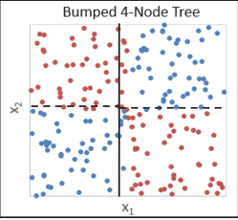
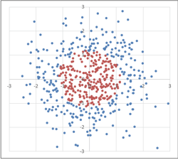
Limitations
If categorical but not ordinal, tree algorithm needs levels to be ordered
Example: Deductibles 100, 500, 1000 as a text field will be ordered 100, 1000, 500.
Some interactions are difficult to find
Notes:
First one: First split won’t find red and blue
Second one: Need 2 (red/blue) but will get 9 – tic tac toe

Slide 14
Boosted Trees

Slide 15
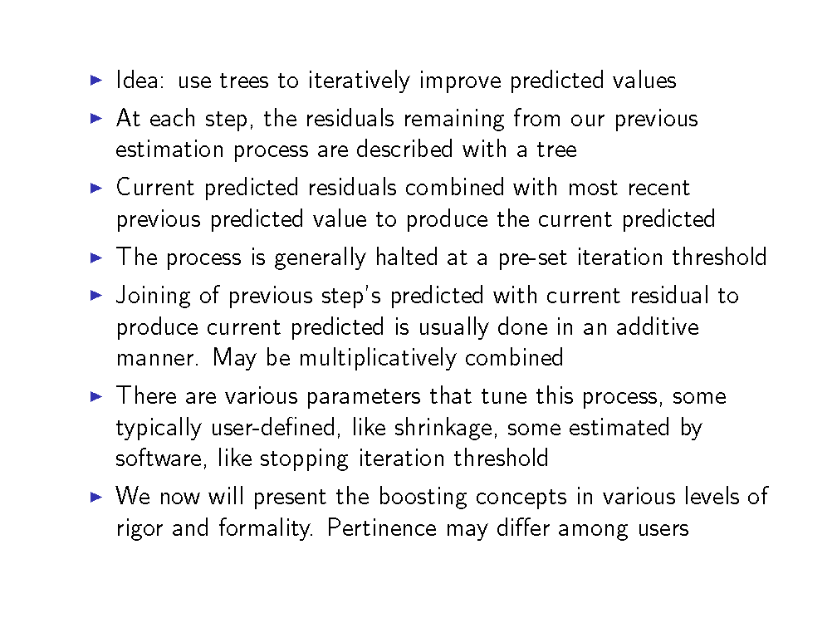
Boosted trees

Slide 16
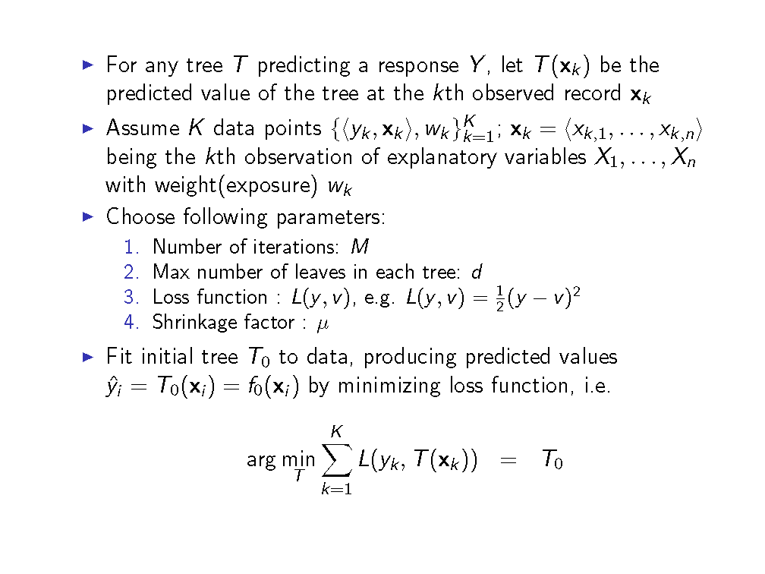
Boosted trees

Slide 17
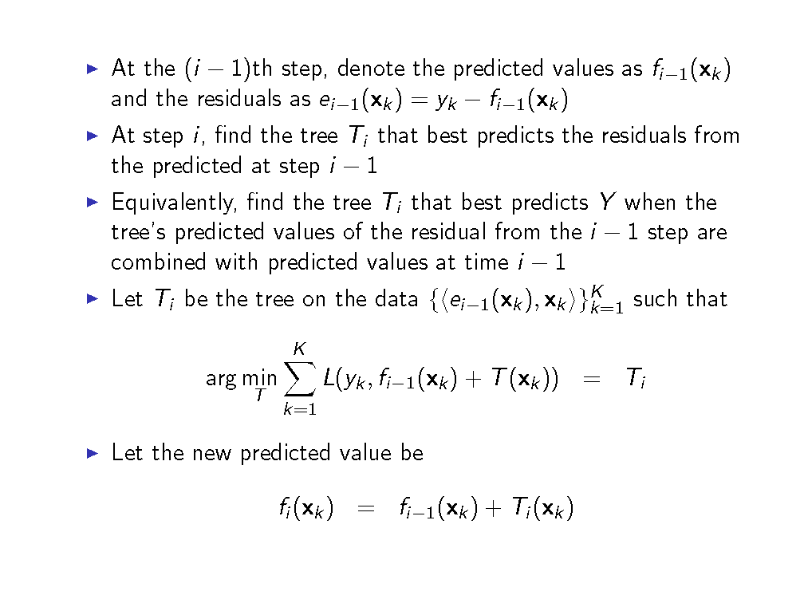
Boosted trees

Slide 18
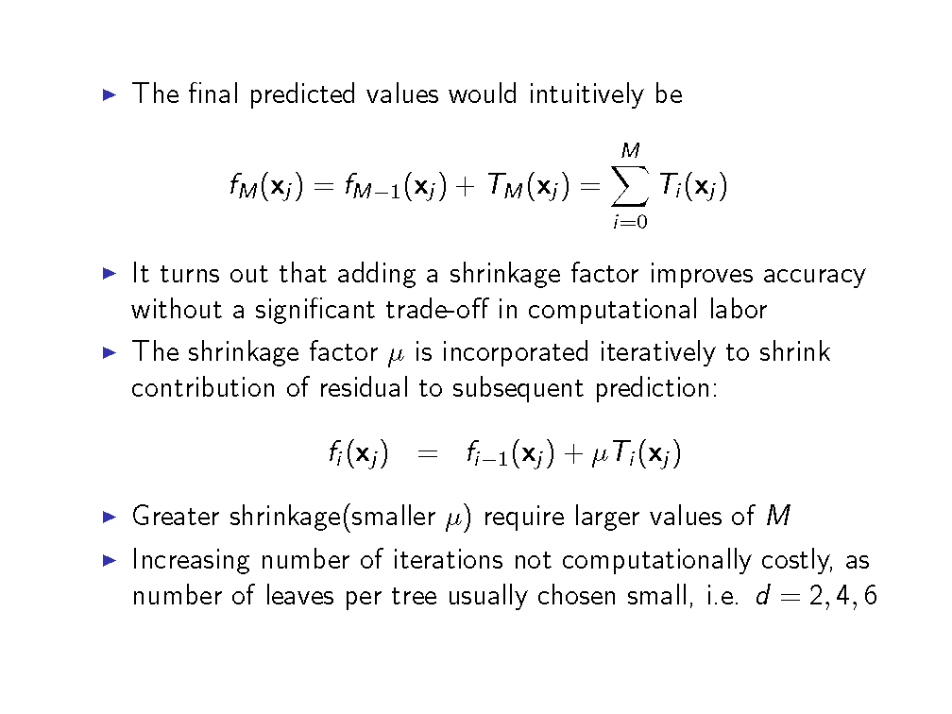
Boosted Trees

Slide 19
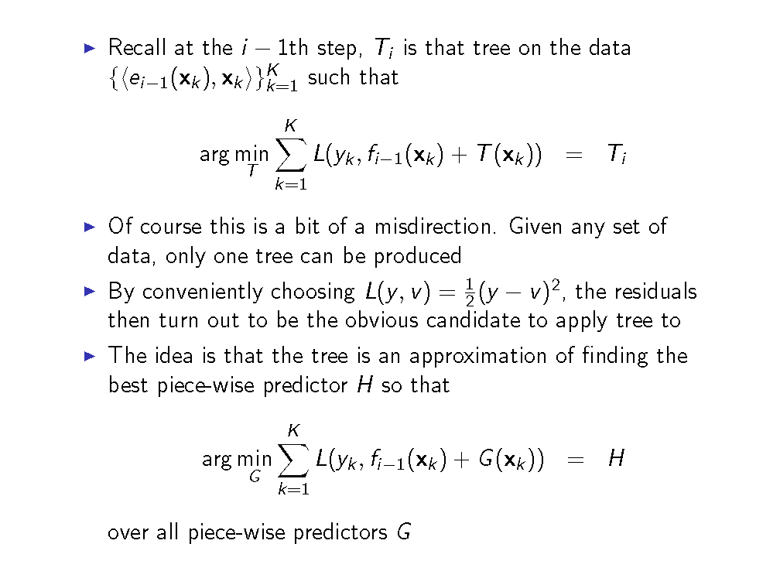
Boosted trees-comments

Slide 20
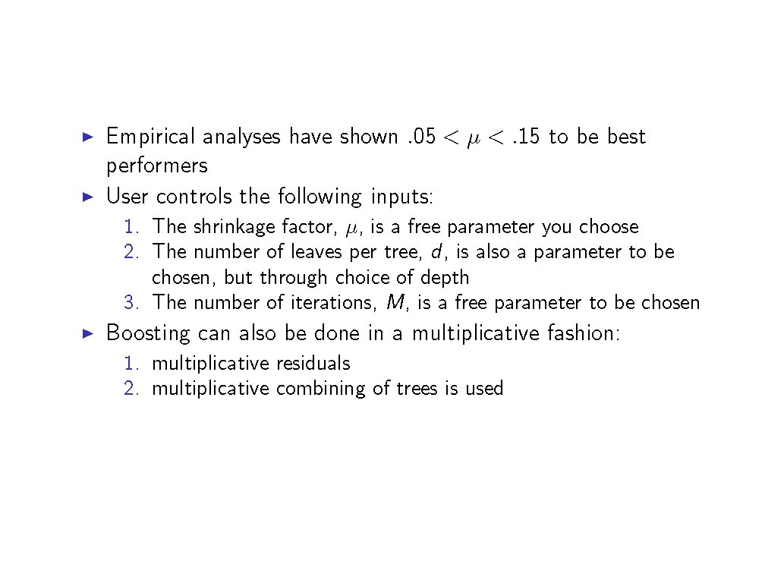
Boosted trees-comments

Slide 21
Boosted trees – further topics
Multiplicative Boosted Trees
AdaBoost
Gradient Boosting

Slide 22
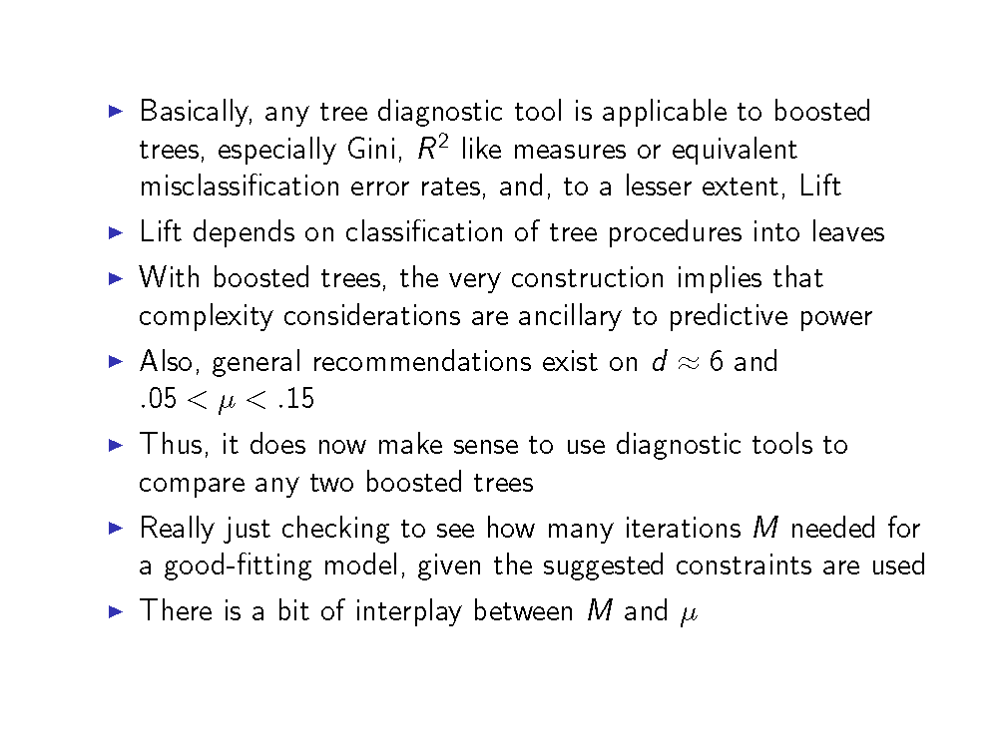
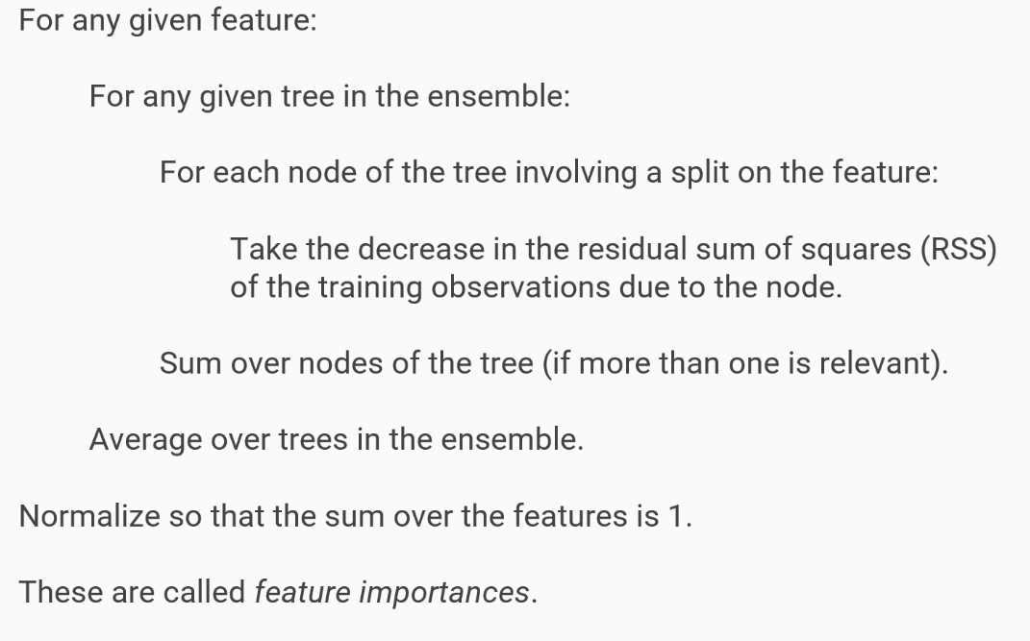
Boosted trees diagnostics

Slide 23
Random Forests

Slide 24
Random Forests - Overview
A Random Forest is an ensemble of decision trees.
Each tree is built using
a random sample with replacement of the observations
a random sample without replacement of the explanatory variables
The predicted target value is the mean predicted target value over the ensemble
Notes:
Note: The trees aren’t pruned (although a maximum depth may be specified), so typically each tree is overfitted. However, due to bagging and feature sampling, the ensemble is less so, typically much less so.
Trees low bias, high variance. Random forest maintain low biasness, reduces variance.

Slide 25
Random Forests - Details
Trees are “greedy”
Perturbing - non-optimal cuts ought to be considered
In the Random Forest procedure, perturbation is implemented by, at each node, only searching for optimal splits among a randomly chosen subset of the explanatory variables.
Notes:
Greedy nature of trees:
Trees seek the best univariate decision at each state
This will miss preferable collections of leaves
In particular, a non-optimal cut can and often does lead to much preferable cuts later in the tree-growing process

Slide 26
Tree Diagnostics
dfs
Notes:
Greedy nature of trees:
Trees seek the best univariate decision at each state
This will miss preferable collections of leaves
In particular, a non-optimal cut can and often does lead to much preferable cuts later in the tree-growing process

Slide 27
Appendix

Slide 28
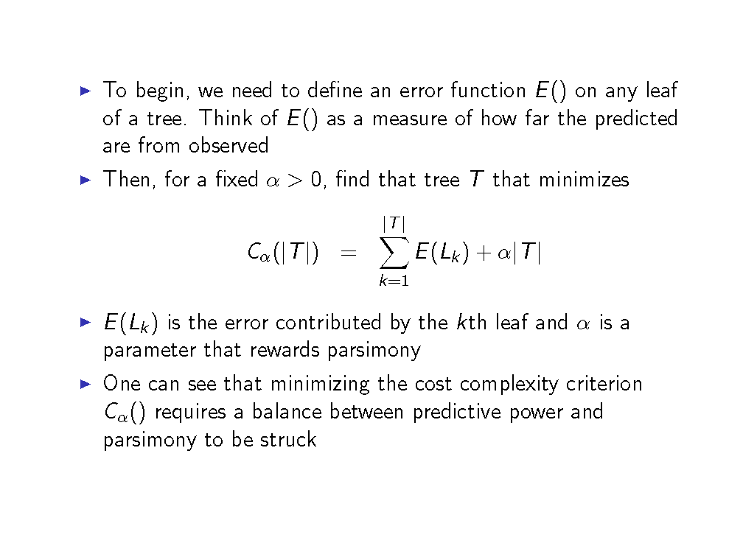
Stopping Criterion – Regression Trees

Slide 29
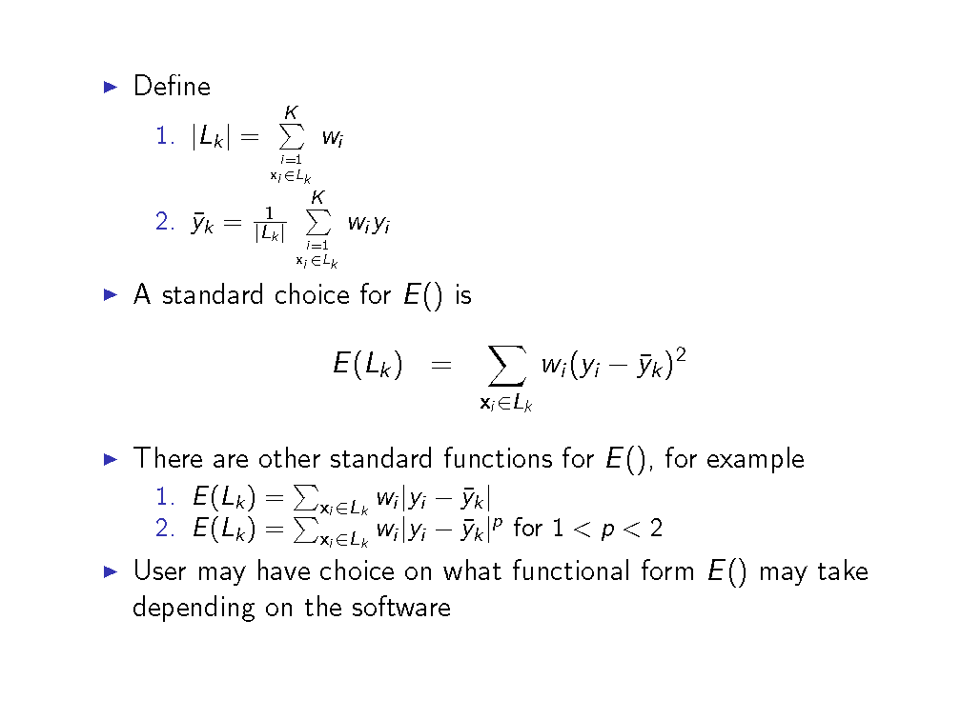
Stopping Criterion – Regression Trees (cont.)

Slide 30
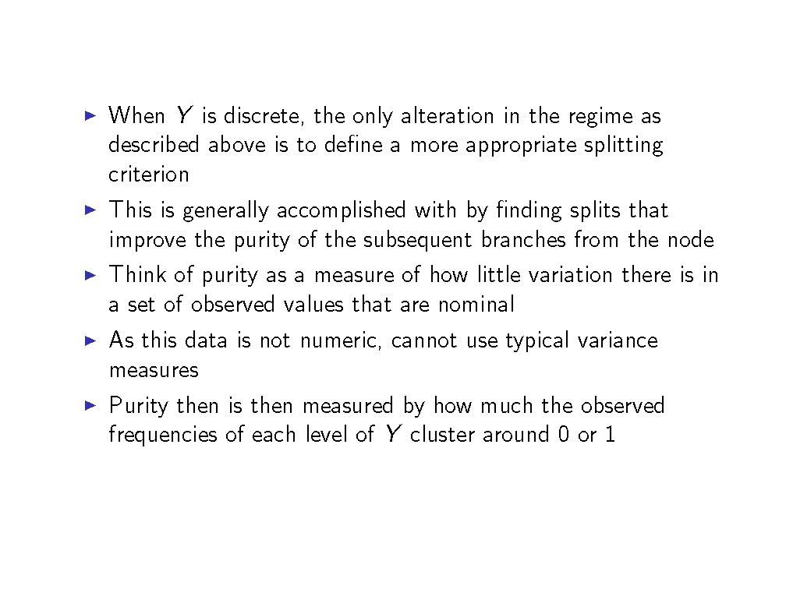
Classification trees

Slide 31
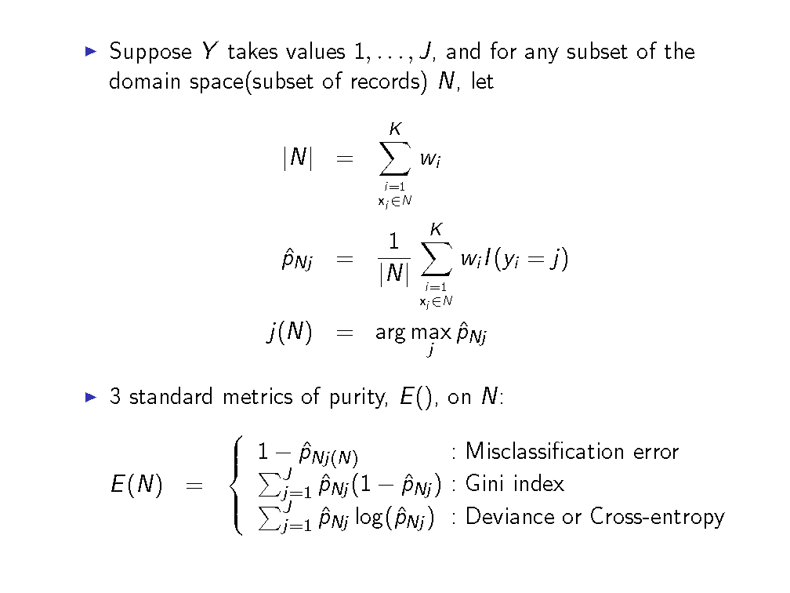
Classification trees

Slide 32
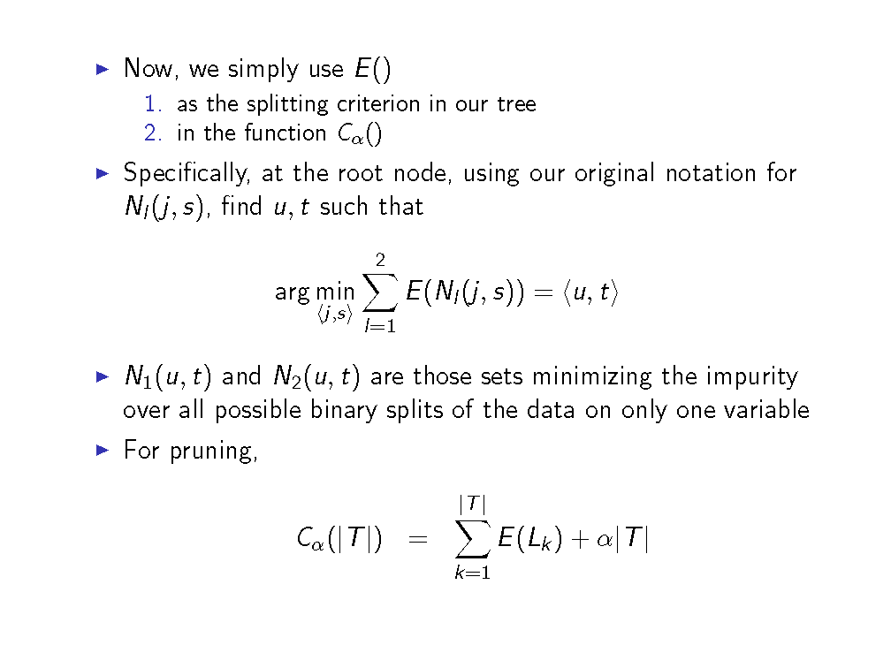
Classification trees

Slide 33
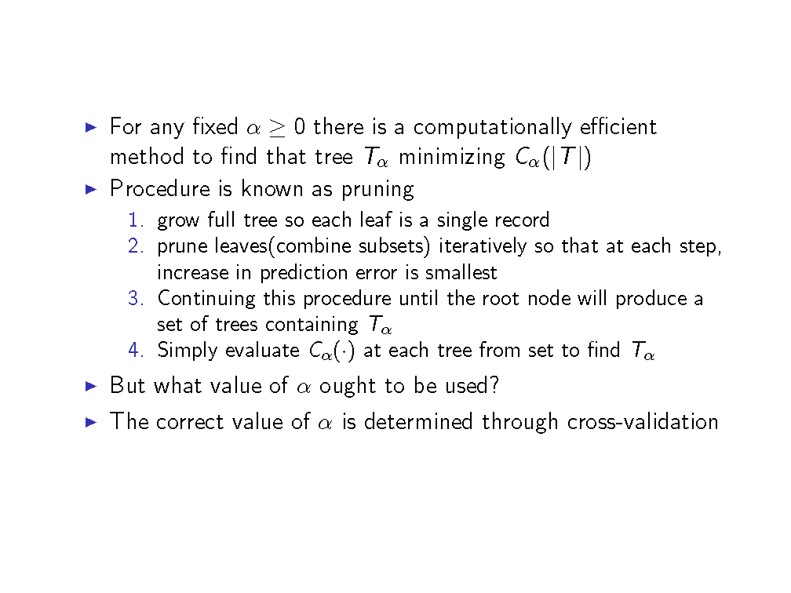
Estimating α

Slide 34
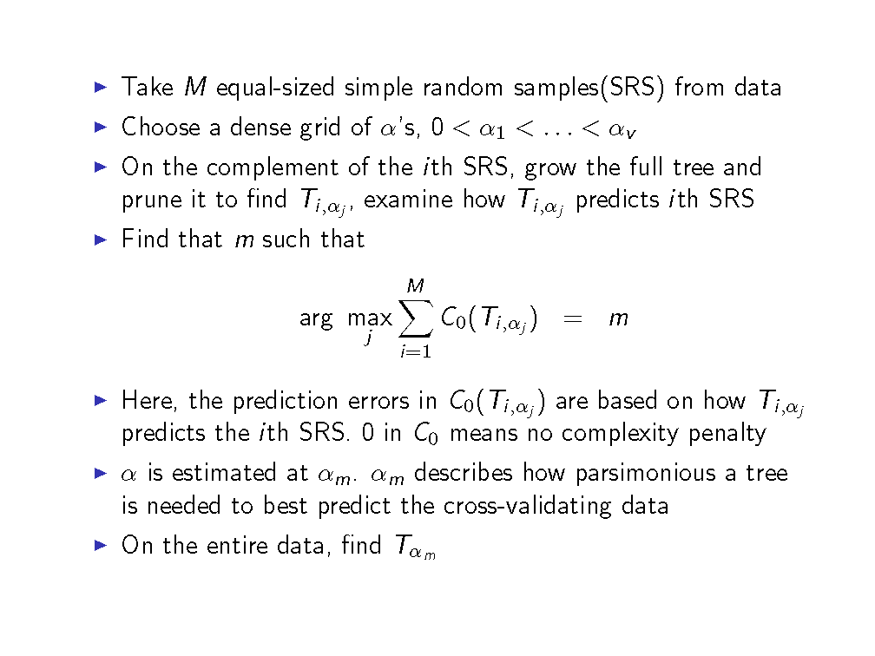
Estimating α with cross validation

Slide 35
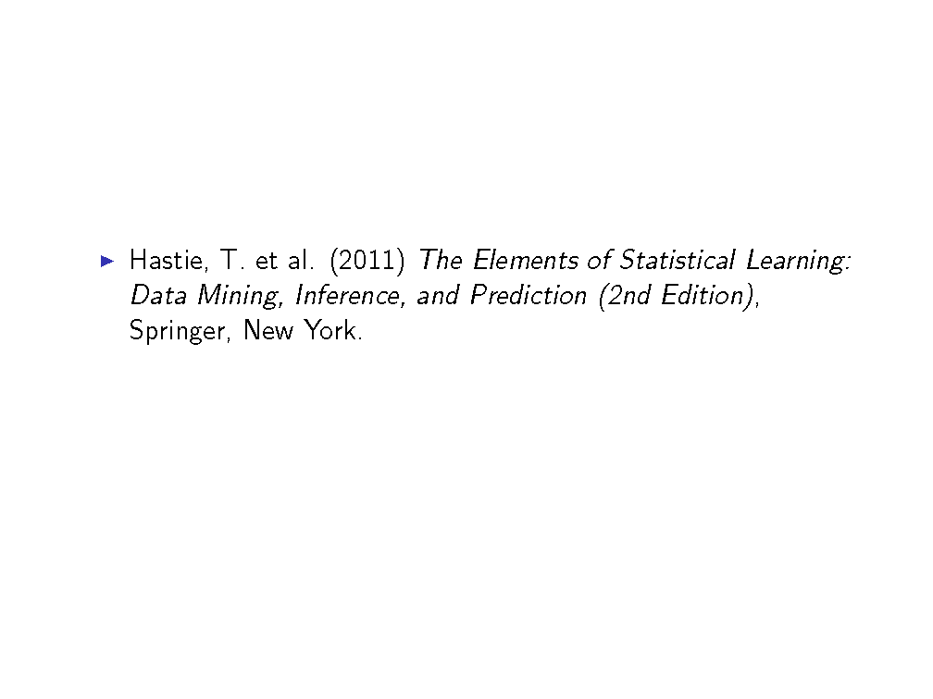
Bibliography

